Slide 1
First Responder Trauma
Helping Those Who Help Others
A Mental Health Professional’s Guide
Gary Dietz LPC Intern LMFT Associate ASAT
Under the Supervision of:
Dr. Russ Bartee LPCS LMFTS
Notes:
Recently I lost a family member, no not my immediate family, my police family. Officer Garret Hull, who I had met was killed in the line of duty, doing a job he loved and served valiantly. And it rekindled my sense of outrage and sadness that someone I served with was now gone, all because of the selfish actions of a crazed gunman and his accomplices.
While most of us are familiar with trauma military personnel encounter, the topic of first responder gets little press and as a recovering trauma survivor, I can attest first responder trauma is real
My goal here today is to briefly let you peek inside the mindset and some of the realities of first responder trauma, with the hope that I might be able to enlarge your understanding and perspective so when you are working with a first responder or a first responder family, you might have a little more information and hopefully have a bit be more comfortable and competent working with first responders
I have an admission. I’m not an expert, so much in clinical research on this topic, but I come at this subject as one who has witnessed, experienced and observed firsthand how responders cope with the traumas associated with their job.

Slide 2
My Friend Mike

Slide 3
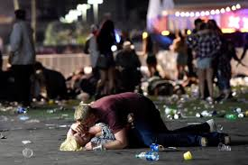
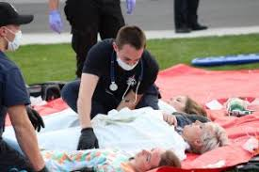
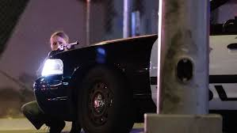
In the Line of Duty
When Tragedy Strikes
Notes:
A year ago we all witnessed horror unfold in Las Vegas as a crazed gunman unleashed his lunacy and anger on a crowd of thousands, murdering 58 wounding 489 and impacting hundreds of families and once again shocking our nation of the savagery that lies within the human heart.
I like millions of others sat glued to the TV, watching in disbelief as the body count went up and the imagery of terrified concert goers fled in fear, running past the lifeless bodies of innocent concert goers and hearing the cries for help from those wounded in the carnage.
As all this was unfolding, I found myself mentally walking through the carnage as a police officer, filled with questions, wondering where is the gunman, how do we get to him, how do I stop this killing field, how do I help the wounded, how do I preserve the crime scene.
Like hundreds of active shooter scenarios I had trained for over the course of 25 years, I found myself transported to that Las Vegas scene, running into battle to stop the pain.
As I contemplated the carnage and the brave actions of all the first responders I thought about they experienced and how they, the officers, firefighters and EMTs will fare in the future as they look back on this horrible day and wonder, “Did I do all I could do? Is there anything I could have done different? Should I have turned right when I turned left? And those thoughts and questions will fill the minds and hearts of those first responders for years to come as inquiry after inquiry and investigation after investigation will dissect the actions and events of that night and point out the bravery and heroism of those first responders and scrutinize every action of those brave heroes, adding to the pain each of those men and women will experience in the months and years to come.
And I care about that! As a former first responder of 25 years who has experienced and faced tragedy and horror in the face, I care about those men and women, because I identify with them. They are my brothers and sisters, my colleagues and friends, though I don’t know them by name, I’m one of them.
I am a trauma survivor. I am a police officer, retired yes, but in my heart, still very much a police officer much akin to Marines, who though may have left military service, are still marines. Once a marine, always a marine. Once a police officer, always a police officer.

Slide 4
Societal Views
Idolized
Mythologized
Scrutinized
Demonized
Ostracized
Notes:
Within society people look at first responders in different ways.
Within society we are most familiar with police officers and fire fighters.

Slide 5
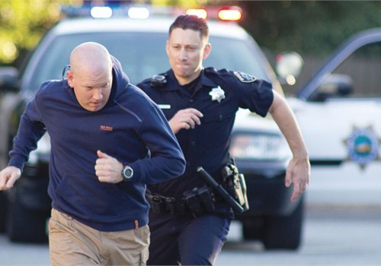
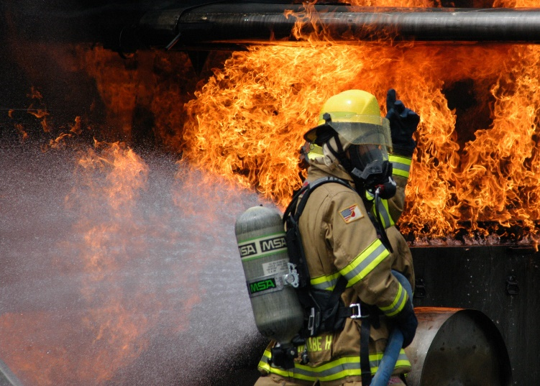
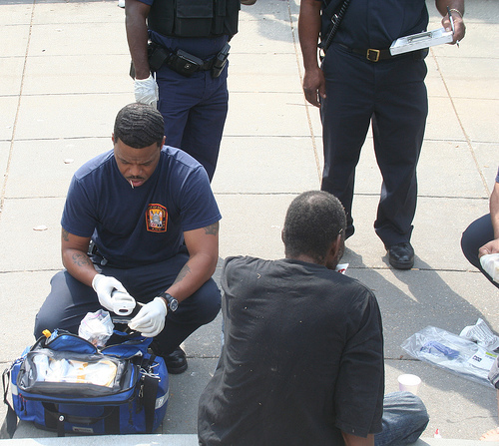
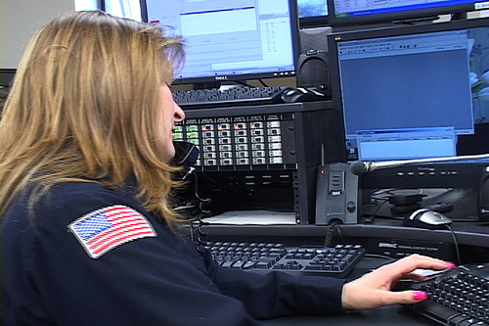
First Responder heroes
Notes:
Who are the first responders?
We know most of them, but each population is a little different.
Each has their own sets of challenges and may experience different types of trauma

Slide 6
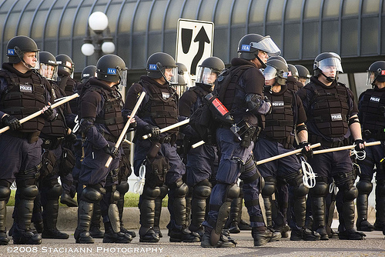
A Unique Subculture
Hero to Zero in Three Seconds Flat
Notes:
First responders are often looked upon as modern day heroes, rushing in to safe the day,
One minute you can be the hero and the next a zero

Slide 7
Law Enforcement
Notes:
With 25 years in law enforcement, I have an affinity and greatest understanding of police work and the police culture.

Slide 8
Police Culture 101
Everything You Wanted to Know About Law Enforcement but Forgot to Ask

Slide 9
Cops are not eager clients. It takes a lot for them to seek help and very little to turn them off. Therapists who make mistakes with cops don’t get second chances. The number one error clinicians make treating cops is failing to understand what they do, why they do it, and the culture in which they operate. The clinician who works with a police officer or police family is like a sociologist or an ethnologist who is entering a closed culture with high levels of distrust for outsiders.
Kirschman,E.K., Kamena, M., & Fay, J. (2014), Counseling Cops. New York, Guildford Press.
The Clinician’s Dilemma

Slide 10
Police Culture 101
Therapist
Police
Similar but Different
Cope with people in crisis
Motivated to help people
Problem solvers
Help relieve suffering psychologically
Help resolve conflict through indirect action, suggestion and cooperation
Employ contemplative strategies
Cope with people in crisis
Motivated to help people
Problem solvers
Relieve and prevent suffering by putting bad people in jail
Resolve interpersonal conflict through direct action
Action oriented strategies
Notes:
Crisis-T-not just to talk
Crisis-P-My neighbor lets his stupid dog poop all over my yard. “What are you going to do”
Prob- T-What seems to be the problem? C-Move your car please. Now---
Fight Crime and suppress evil FW-Sit Down, Buckle in, We’re going to war

Slide 11
Action oriented
Comfortable giving and taking orders
Value variety & excitement
Assertive
Decisive
Willing to be in the public eye
Value predictability, conformity, tradition and structure
Great at emotional control
Can be emotionally guarded
General Attributes

Slide 12
Generally dismissive of emotional sensitivity
Their job is about control. Control of their own reactions. Control of self. Control of others. They are called when there is a loss of control.
Cautious of revealing feelings because in their work revealing emotions can lead to trouble.
Accustomed to gore. Be prepared to hear horrific stories.
Have a funny sense of humor which may be morbid, strong and perhaps a bit crass
Have been very thoroughly screened at pre-employment.
As a rule, very hearty and resilient individuals.
Values, Mindset & Occupational Realities

Slide 13
Police Culture 101
Bill had been in two shootings that resulted in his killing two suspects. He was having nightmares and seriously considering quitting police work in order to avoid the possibility of third deadly encounter. His department EAP referred him to a local clinician who had a lot of experience, none of which involved law enforcement. This was Bill’s first-ever counseling session. The therapist listened to Bill’s story carefully. When Bill was finished talking the therapist asked him, “So, are you ready to stop killing people?” Bill left the session very upset. It wasn’t until he talked to some friends who had been in therapy that he learned how inappropriate and untherapeutic this question was and accepted another referral to someone familiar with the police culture.
Kirschman, Kamena, & Fay, J. (2014), p.8.
An Example of Clinician Cultural Ignorance

Slide 14
Police Culture 101
Under Constant Intense Scrutiny

Slide 15
Police Culture 101
Suspicious

Slide 16
Police Culture 101
Safety Conscious
Notes:
1. In training police officers receive hours upon hours of training on officer safety.
2. Drilled into every officer to be aware of their surroundings to remain safe in order, to stay alive, to keep from being vulnerable.
3. Officers are taught to be wary. Even the 78 year old elderly female can be lethal if in a state of rage can grab her gun and shoot’
4. The mantra, ‘watch the hands. Watch the hands is drummed into every officer. Because, the hands can grab a gun. Hands can be used against you to assault you.
5. Every officer is taught to observe, stand guard, be aware of your surroundings at all times
6. In fact, in some of the street police street survival trainings I’ve attended, we were taught. You’re a sheep dog. People are sheep. The sheep don’t necessarily like the sheep dog but want the sheep dog around to keep them safe.
7. So, officers are taught, trained over and over again, “Officer safety, Stand guard. Officer safety. Officer safety. SO THAT…if your safety is threatened…you FIGHT for your life
8. Just like an officer who several years ago came upon a burglary of a vehicle in progress in a park. foot chase, fight, creek, suspect tried to hold the officer underwater and drown him, Suspect held the office underwater and had his hands on the officer’s mouth who struggling for his life, bit the end of the suspect’s thumb off who recoiled in pain and gave the officer the second to reach for his pistol and shoot the suspect at point blank range, killing the his attacker.
9. Thus, officers are taught, when necessary, fight

Slide 17
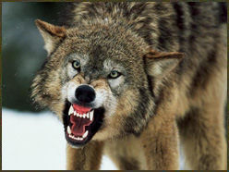
Police Culture 101
Safety Conscious
Notes:
Fight like an attack dog. Your survival depends upon it.

Slide 18
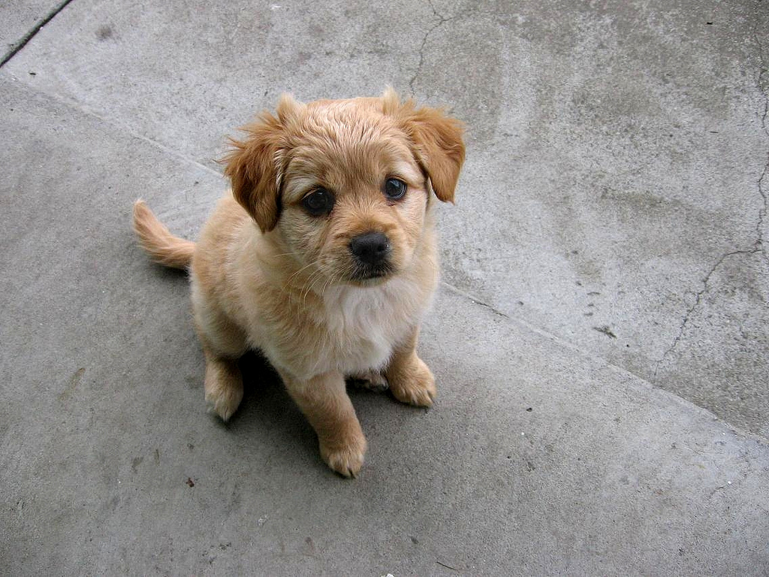
Police Culture 101
Safety Conscious
Notes:
The reality is, the overwhelming majority of those in law enforcement have hearts of gold and deep down simply want to help.

Slide 19
General Distrust of Mental Health Professionals
Police Culture 101
Exposure to severely mentally disturbed individuals often distorts realistic views of psychotherapy
Fear of condition impacting their duty status
Fear of loss of employment
Fear confidentiality will be breached
Not eager clients
Don’t like psychobabble

Slide 20
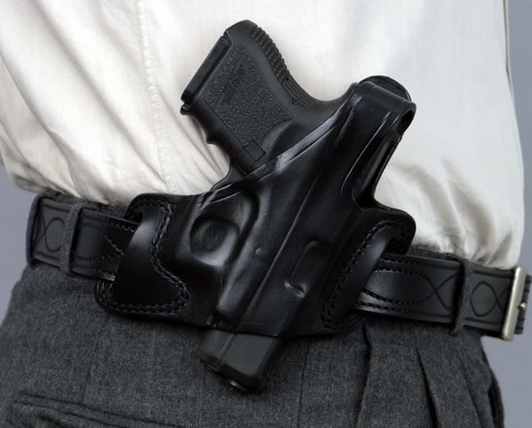
* One Caveat
Cops carry their guns with them!

Slide 21
The Therapeutic Alliance Is PARAMOUNT!
Police Culture 101

Slide 22
The Important Therapeutic Alliance

Slide 23
Navigating the Path to Helping the First Responder…
Initial considerations

Slide 24
Initial Considerations
As Mental Health Professionals:
Recognize the client as a First Responder
Recognize the type of first responder
Police
Fire Fighter
EMT
Dispatcher

Slide 25
Initial Considerations for Law Enforcement Clients
Recognize the first responder status may have nothing to do with client issues
Be more direct
Adopt a learner’s attitude
Identify the client’s present work assignment, time and experience in law enforcement

Slide 26
Initial Considerations for Law Enforcement Clients
TRAUMA

Slide 27
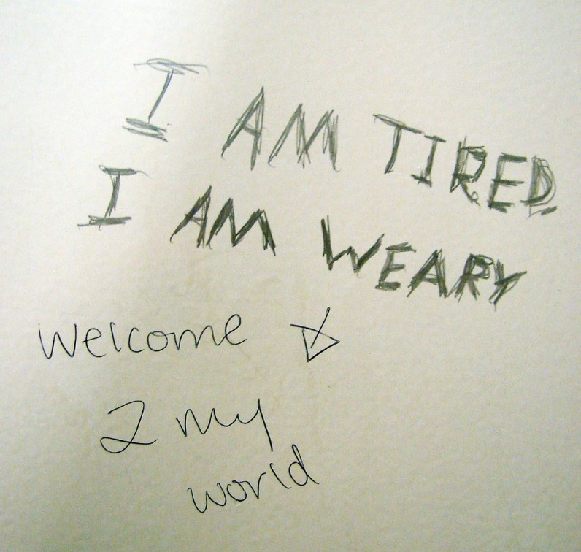
Initial Considerations for Law Enforcement Clients
TRAUMA TYPES

Slide 28
Initial Considerations for Law Enforcement Clients
CRITICAL INCIDENT
Officer perceives his or her safety is threatened
Officer has significant physiological reactions during the incident and unable to calm down after the incident (e.g. resting heat beat 90 beats or more)
Negative self appraisals (e.g. I’m a bad cop because if I was could have prevented that assault.)
Officer dealing with multiple stressors in his or her life
TRAUMA TYPES

Slide 29
Initial Considerations for Law Enforcement Clients
High clinical risk trauma
High clinical risk trauma
Serious line of duty injury
Injury or death to a child
Prolonged exposure to the dead and dying
Victim known to responder
Mass casualty
Undercover work
Traffic enforcement & accident investigations
Suicide of a co-worker
Organizational betrayal
Officer personal safety is jeopardized or injured
Exposure to infectious disease
Negative media attention
Gang units
Felony warrant service

Slide 30
Initial Considerations for Law Enforcement Clients
Critical Incident Trauma
Line of duty death
Officer involved shootings

Slide 31
Common Presenting Problems Among Law Enforcement Clients

Slide 32
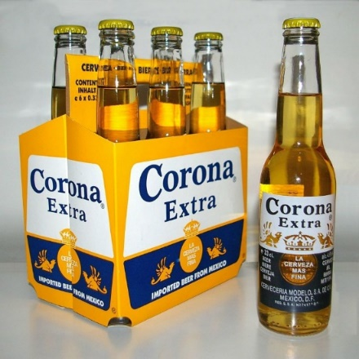
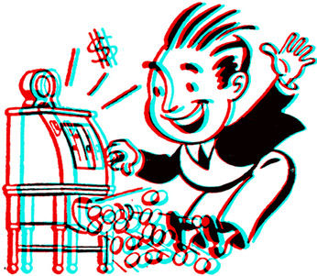
Common Presenting Problems Among Law Enforcement Clients
Alcohol abuse and dependence
Prescription pain medicine abuse and dependence
Symptom or Problem?
Sex Addiction
Gambling
This Photo by Unknown Author is licensed under CC BY-SA
This Photo by Unknown Author is licensed under CC BY-NC

Slide 33
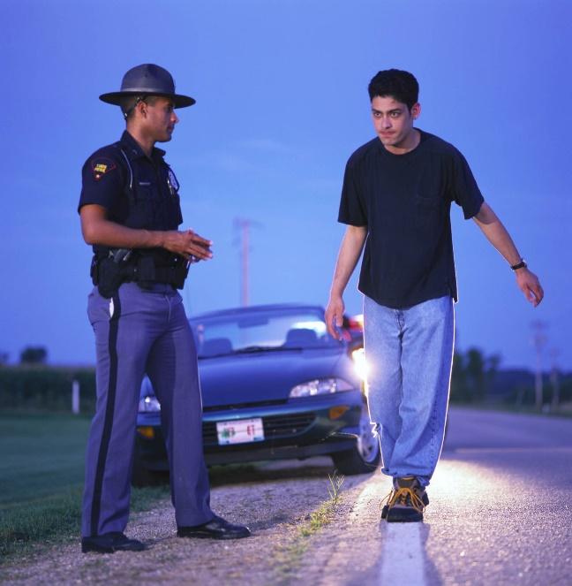
Common Presenting Problems Among Law Enforcement Clients
Career implications
A cooperative approach
Consider possible ongoing investigations
Substance Abuse
&
Behavioral Addictions

Slide 34
Common Presenting Problems Among Law Enforcement Clients
Depression
SUICIDE

Slide 35
The Police Family
RESILIENCE & vulnerability

Slide 36
The Police Family
Department
Personal
Notes:
When we talk about family, a cop has 2 families. They have their personal family, but they’re also part of a larger family, their cop family.
And that family, that cop family is not just locally, its international
Officer ++ funeral.
NYC officers-comraderie
Victoria BC-Customs

Slide 37
The Police Family
Professional Identity
Protector
Governmental Authority Figure
Personal Identity
Spouse
Parent
Crime Fighter/Investigator
Peace Maker
Resident/ Neighbor
Professional Identity
Vs.
Personal Identity

Slide 38
Stories of Pain

Slide 39
The Police Family
Can be a protective factor
Create special challenges for police family members
Police mentality at home
Spousal concerns over safety
Children’s concerns over parents safety
Family stress over media attention
Considerations

Slide 40
Clinician’s Role
Study the culture peculiarities of the first responders population you wish to reach
Volunteer
Do a ride in
Market your services to first responders
Listen and show you care
So What Now?

Slide 41
My Story
Trauma & Healing

Slide 42
RESOURCES
Anderson, R. (2007) Married to the badge: A wife’s tale of survival. Miami, FL.: Blue Line Publishing
Farrens, S. (2005). The fireman’s wife: A memoir. New York: Hyperion.
Kirschman, E.K. (2004). I love a fire fighter: What the family needs to know. New York: Guilford Press.
Kirschman, E.K. (2007). I love a cop: What police families need to know (rev. ed.). New York, Guilford Press.
Kirschman, E. K., Kamena, M., & Fay, J. (2014), Counseling Cops. New York, Guildford Press.
The Badge of Life (www.badgeoflife.com).
The Force Science Institute. (www.forcescience.org)

Slide 43
In Patient Treatment for First Responders
The West Coast Post-Trauma Retreat (WCPR) (www.wcpr2001.org)
On-Site Academy (www.onsiteacademy.org)

